Slide 1
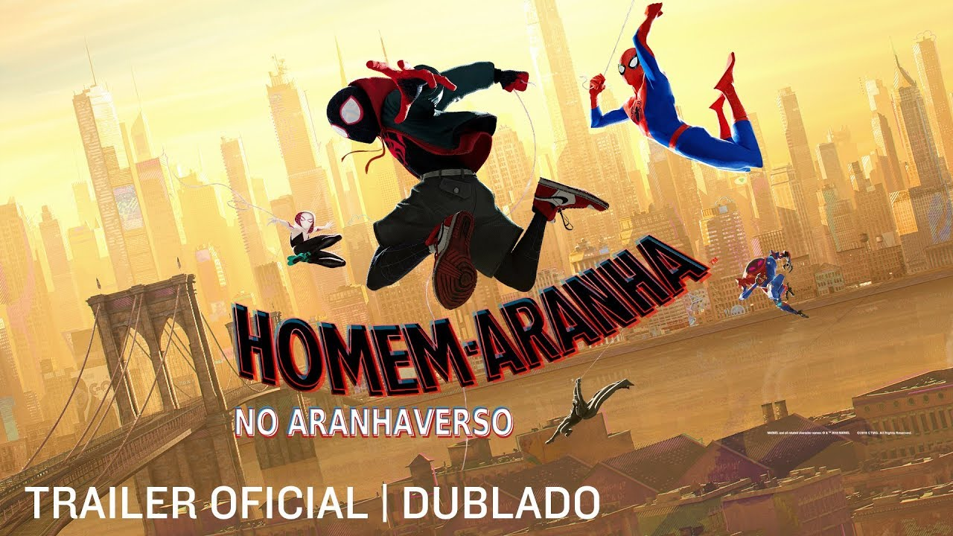



Tuco
Tuco
TUCOVERSO
TUCOVERSO

Slide 2
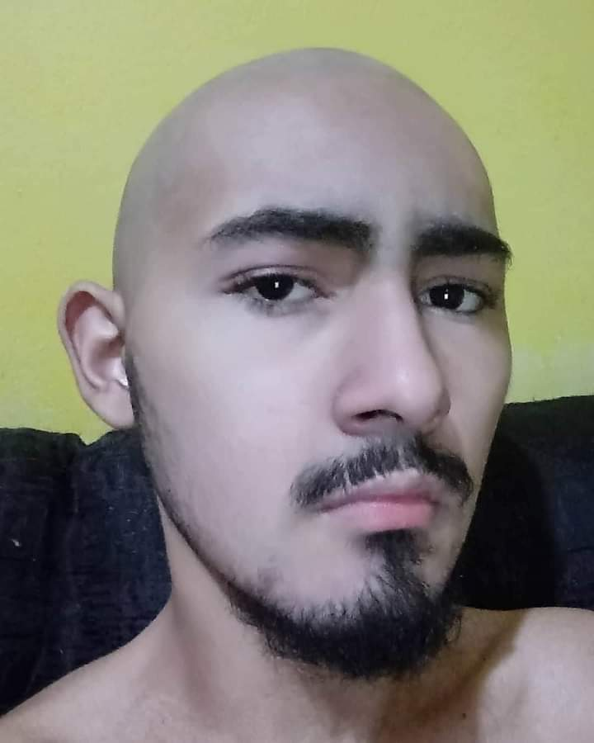
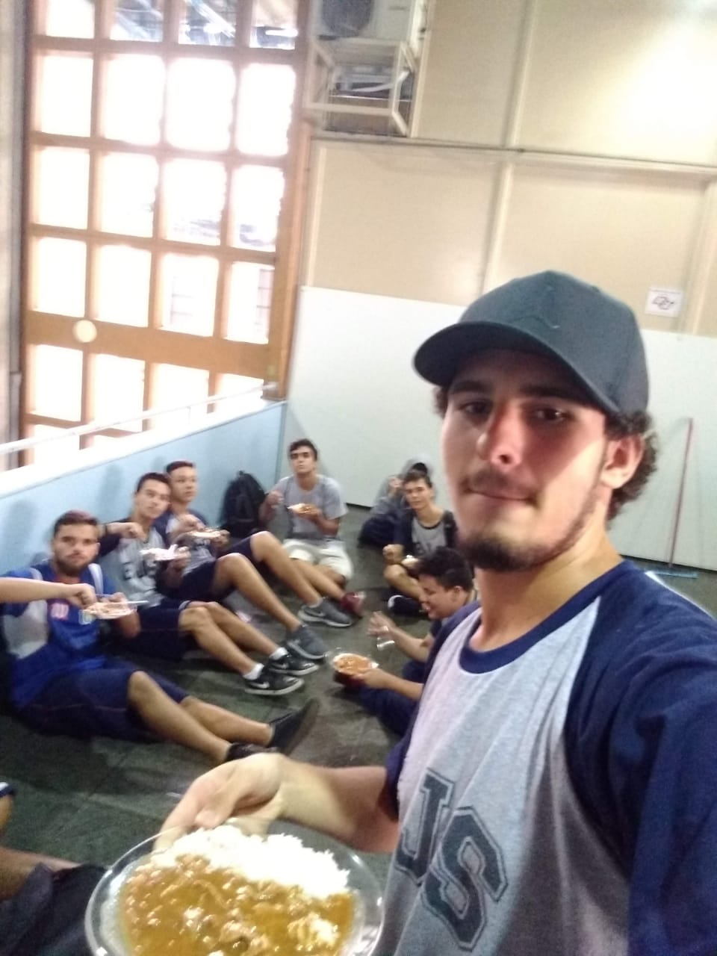
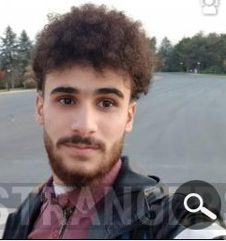
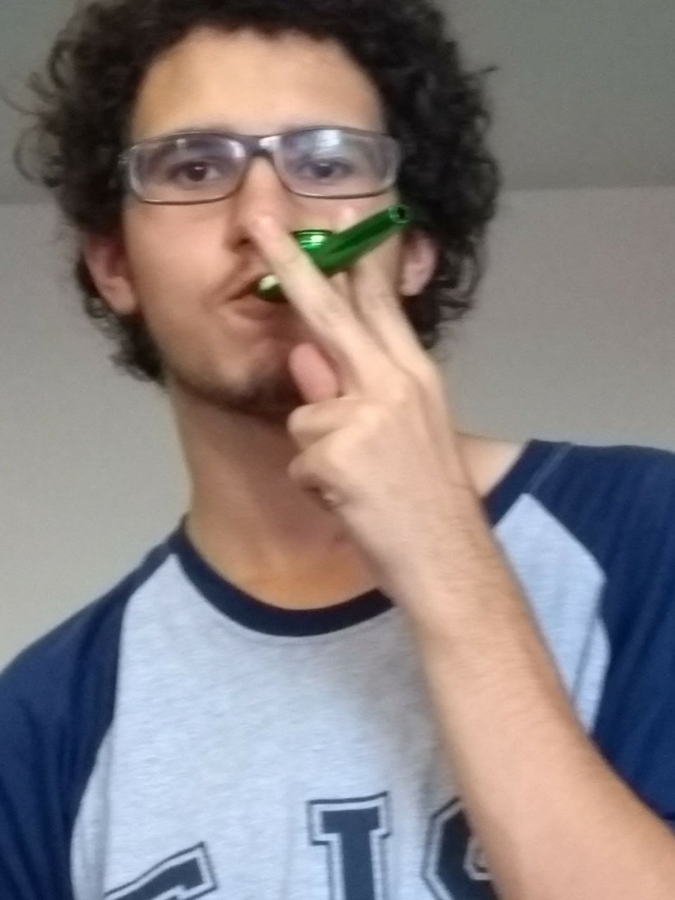
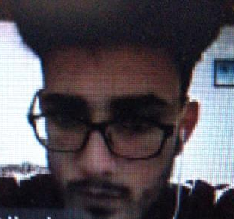



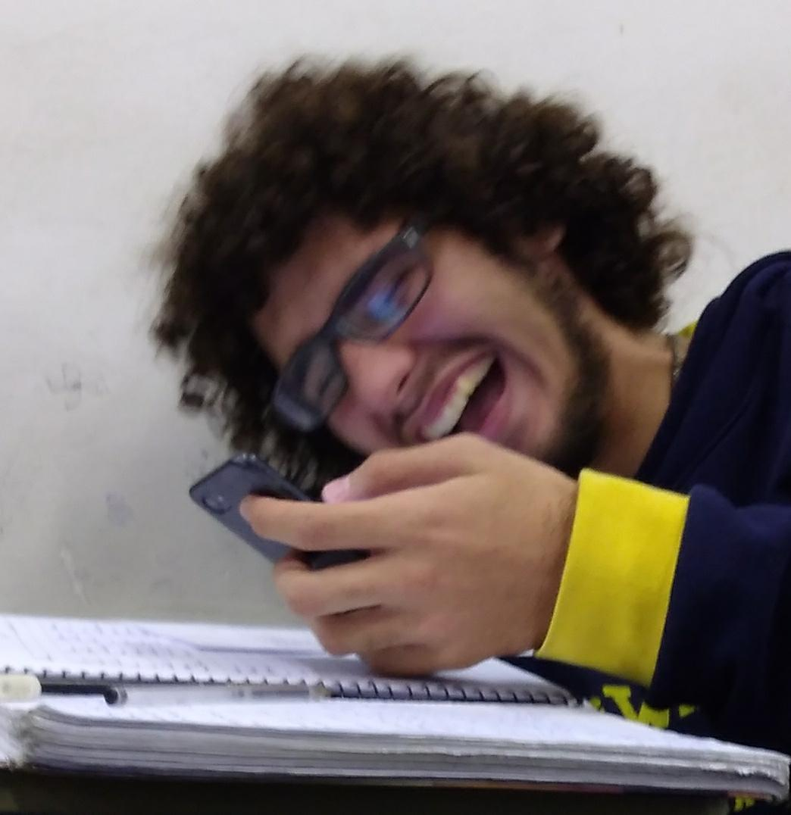
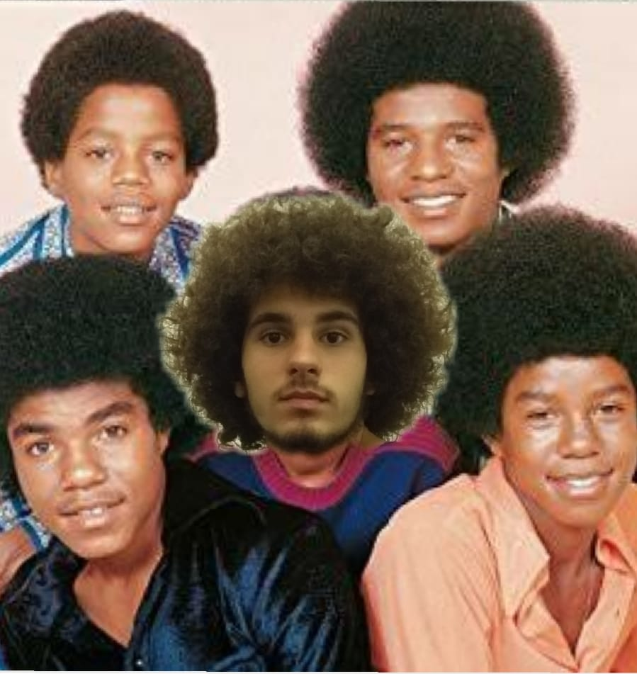
Tuco
TUCO
CARECA
TUCO
PEDREIRO
TUCO
PALESTINO
TUCO
FUMANTE
TUCO
DE ADS
Tuco
TUCOVERSO
TUCOVERSO
TUCO
DORMINDO I
TUCO
DORMINDO II
TUCO
PRAIEIRO
TUCO
MENDIGO RINDO
TUCO
JACKSON 5

Slide 3
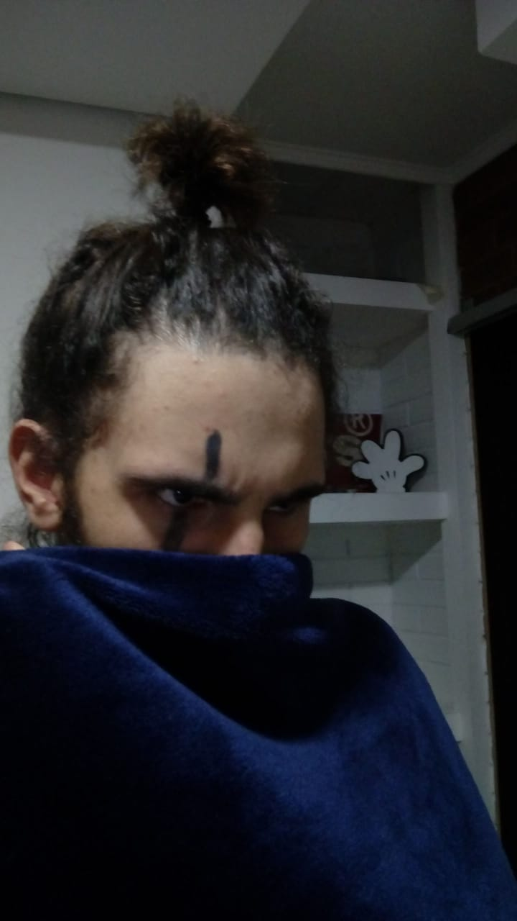
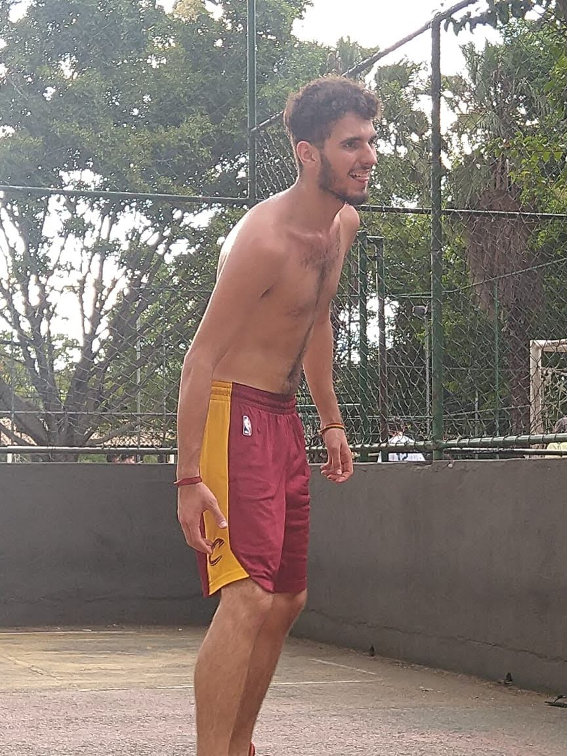
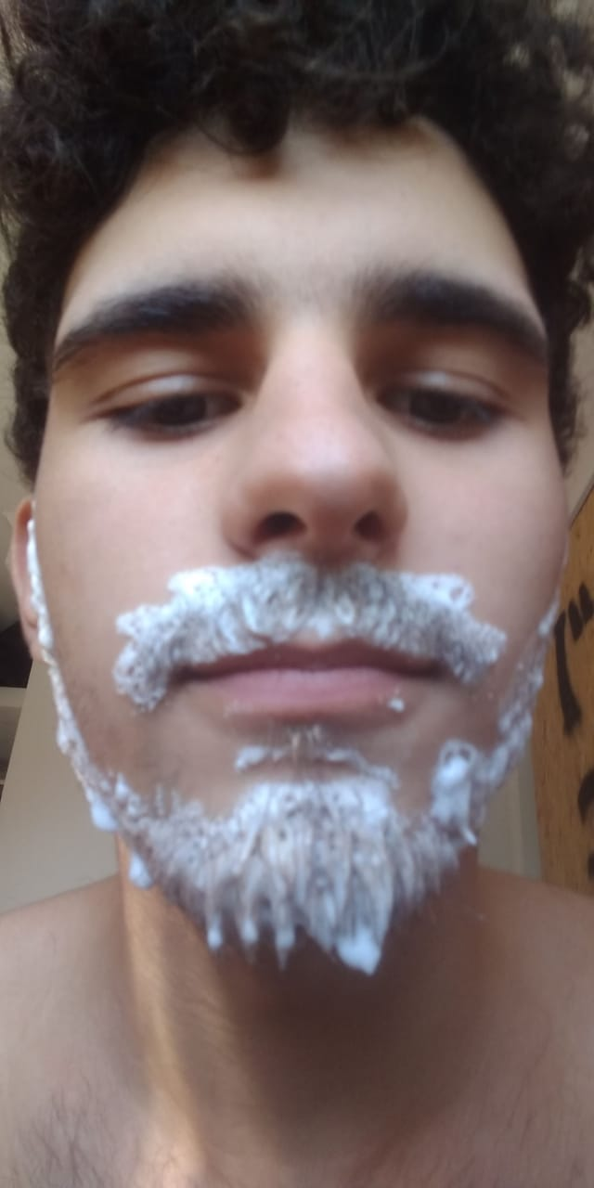
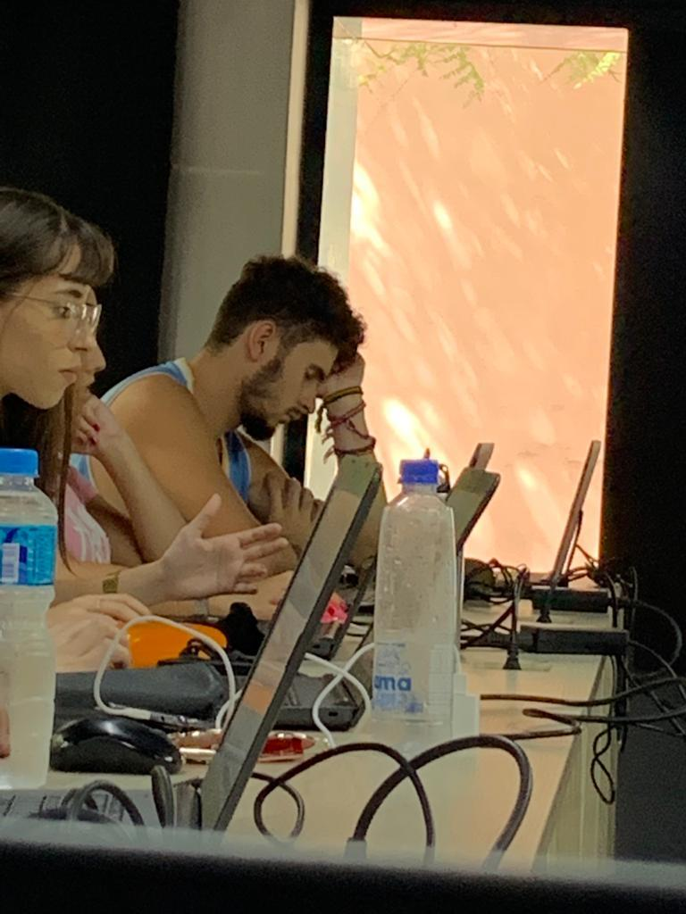
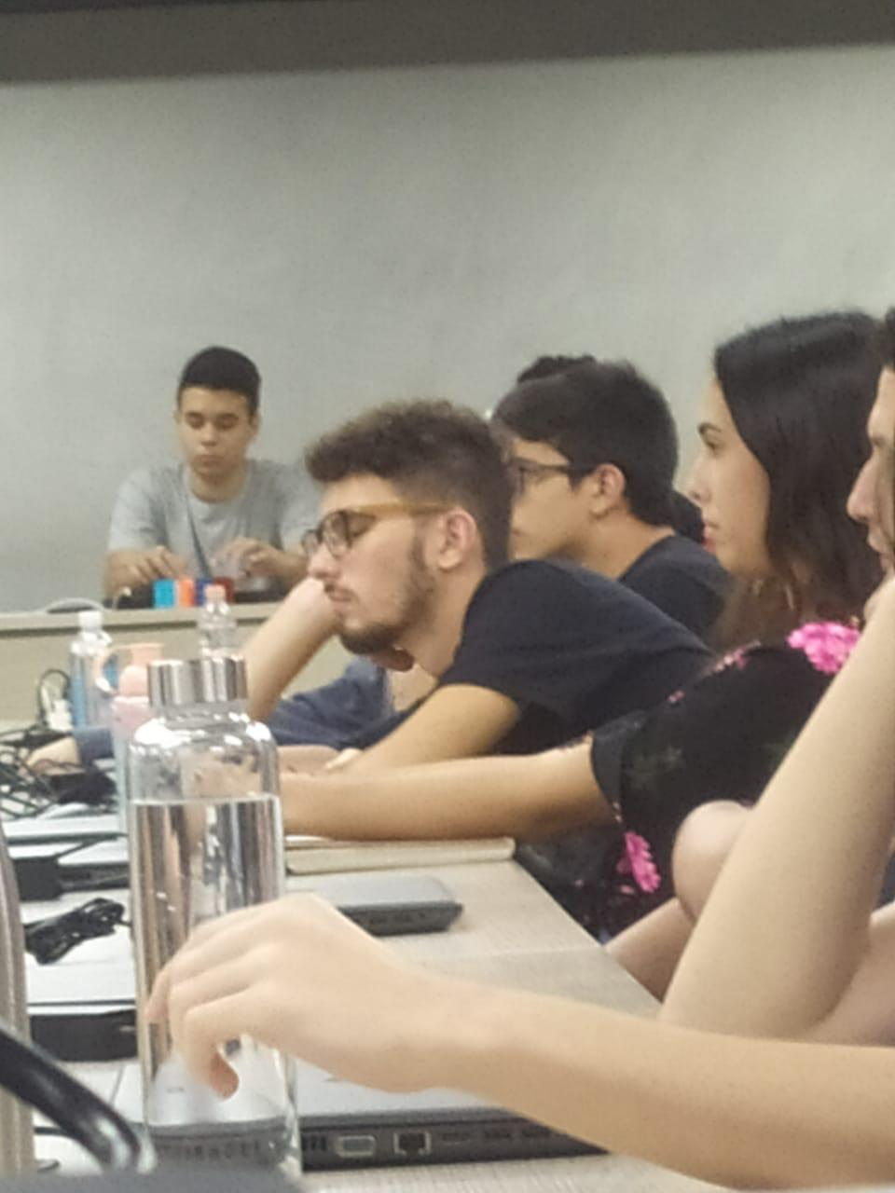
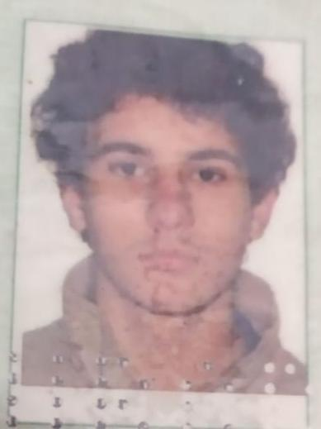
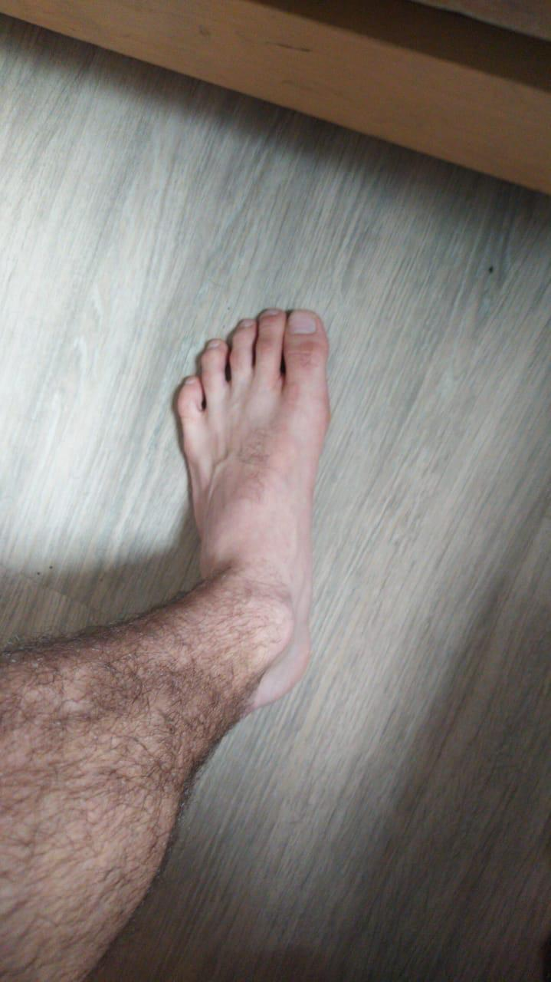
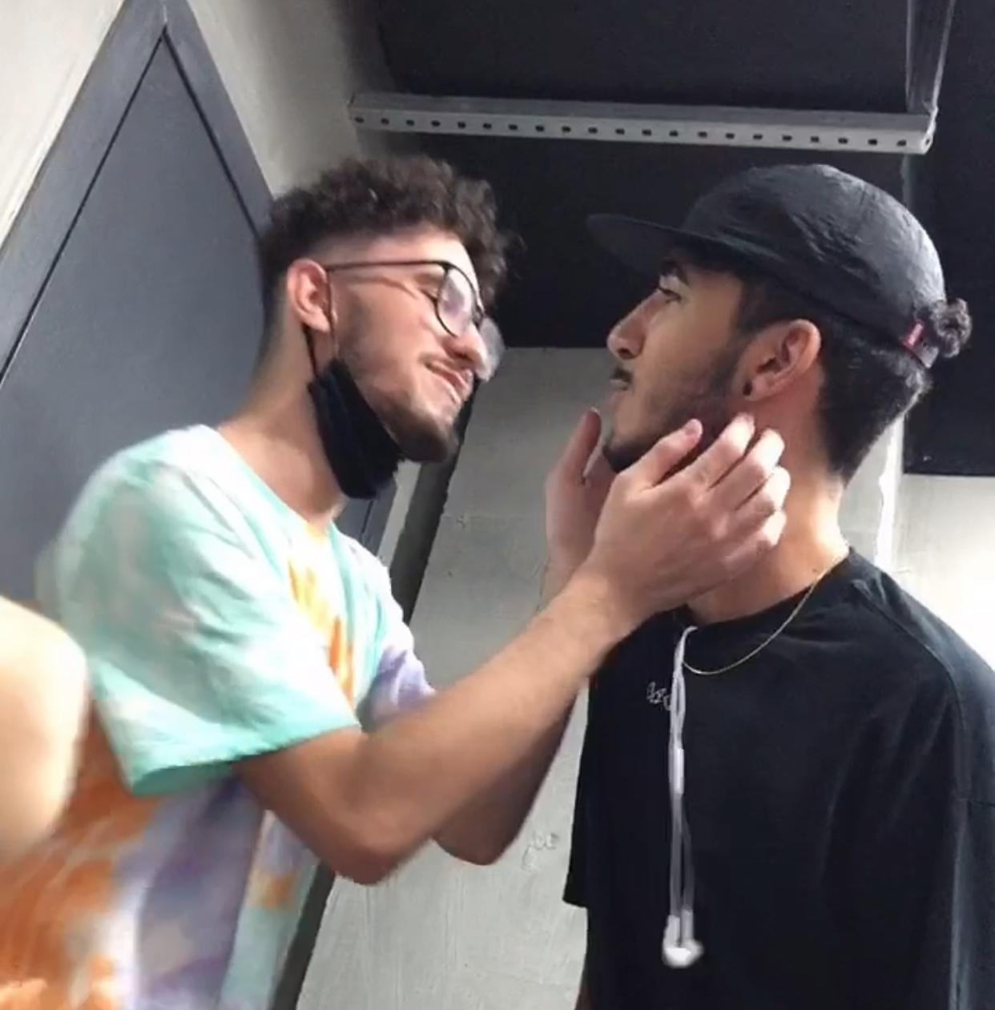
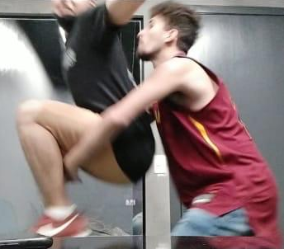

Tuco
TUCO
OTAKU
TUCO
BASQUETE
TUCO
BARBEIRO
TUCO
DORMINDO III
TUCO
DORMINDO IV
Tuco
TUCOVERSO
TUCOVERSO
TUCO
RG
TUCO
PÉ
TUCO
ROMÂNTICO
TUCO
SARRADOR
TUCO
VESGO

Slide 4
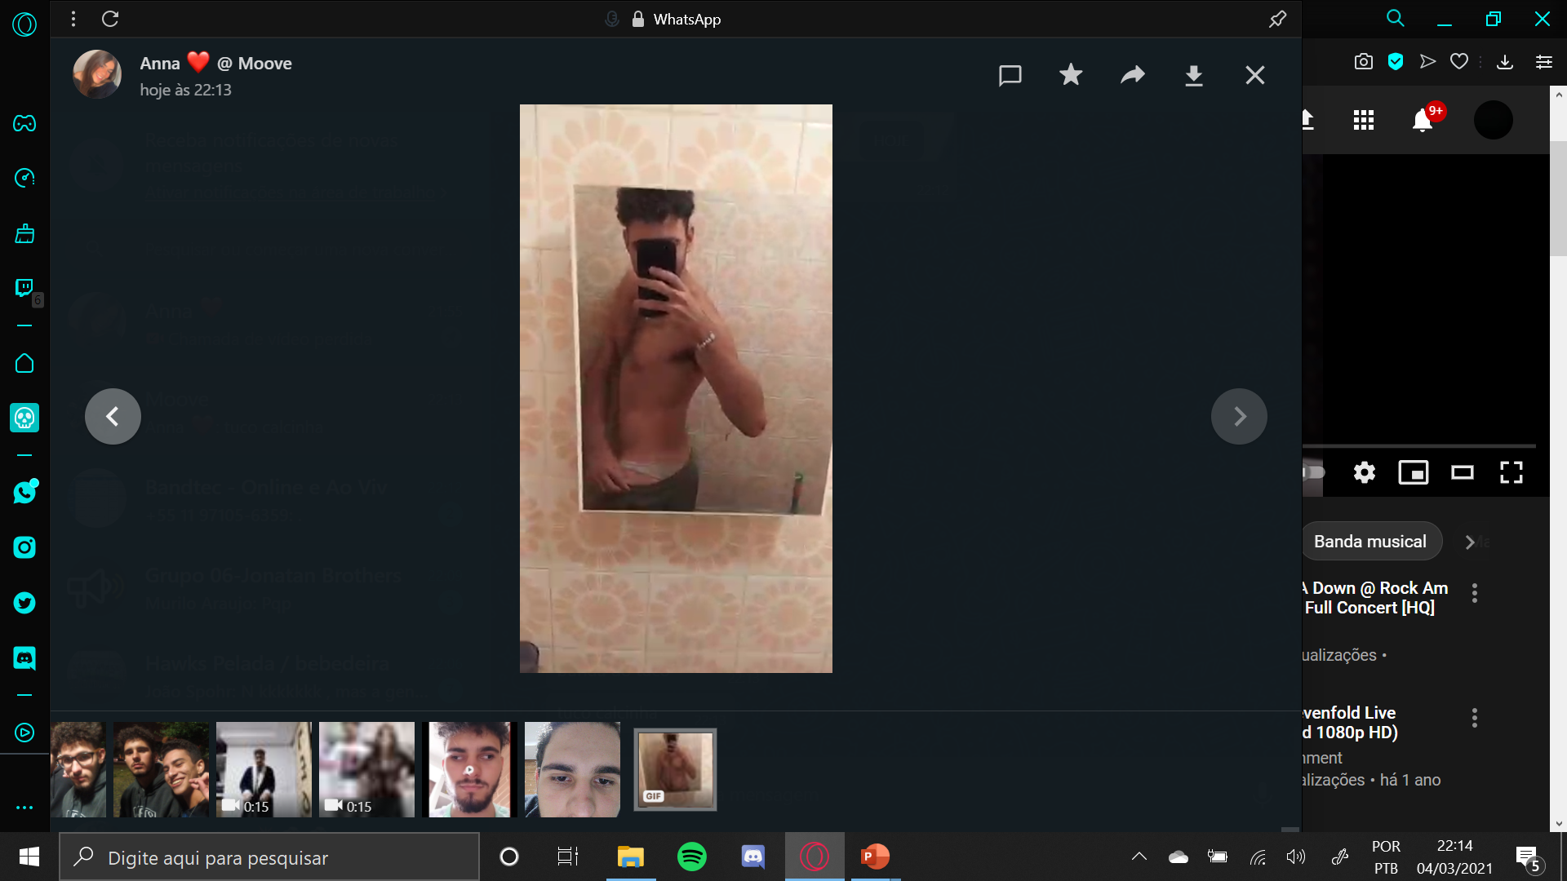
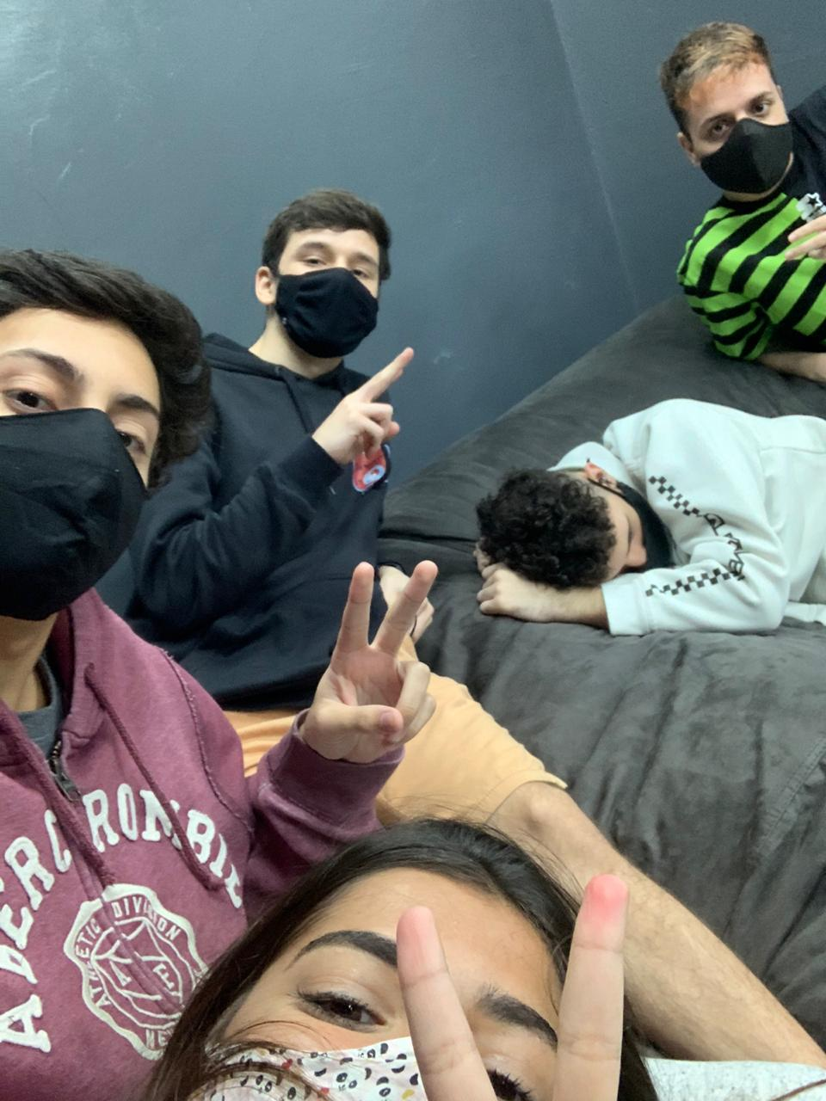
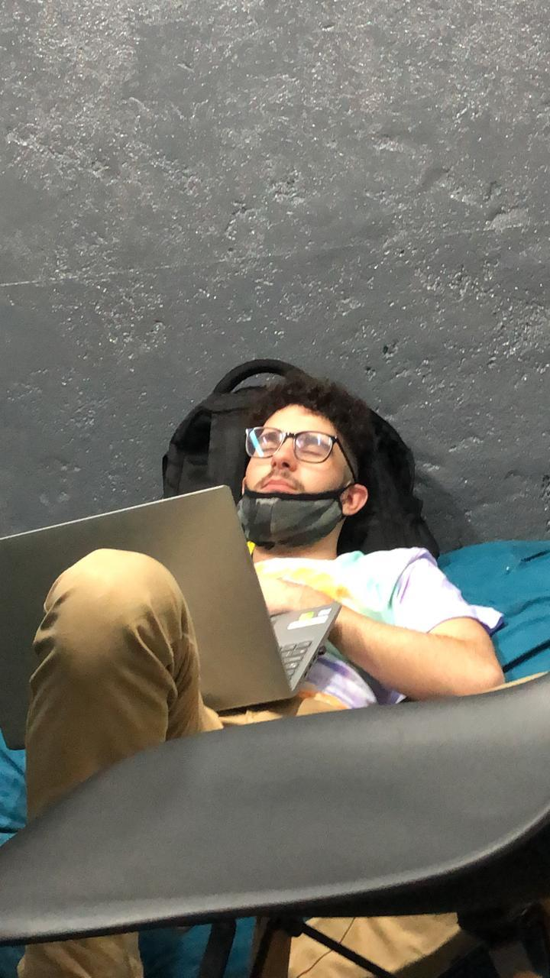
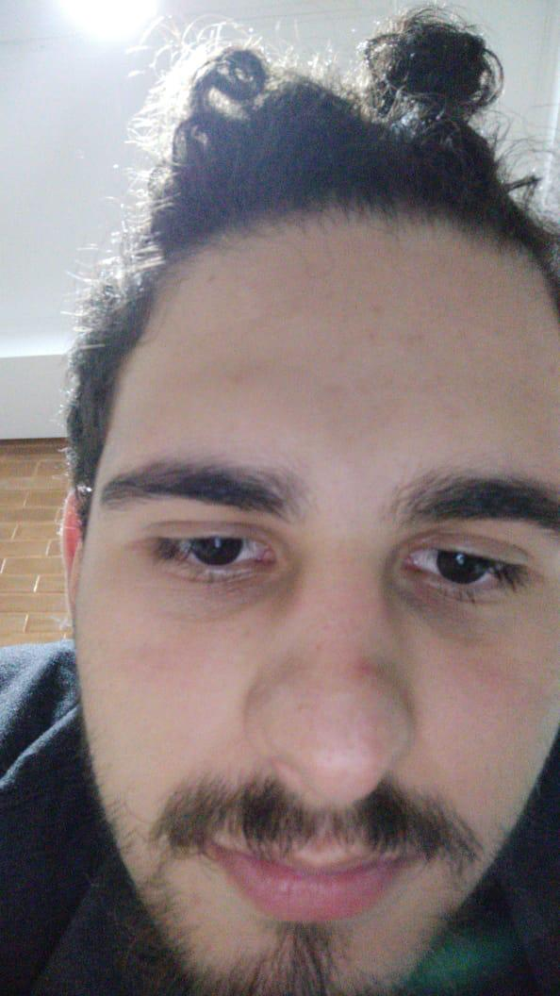
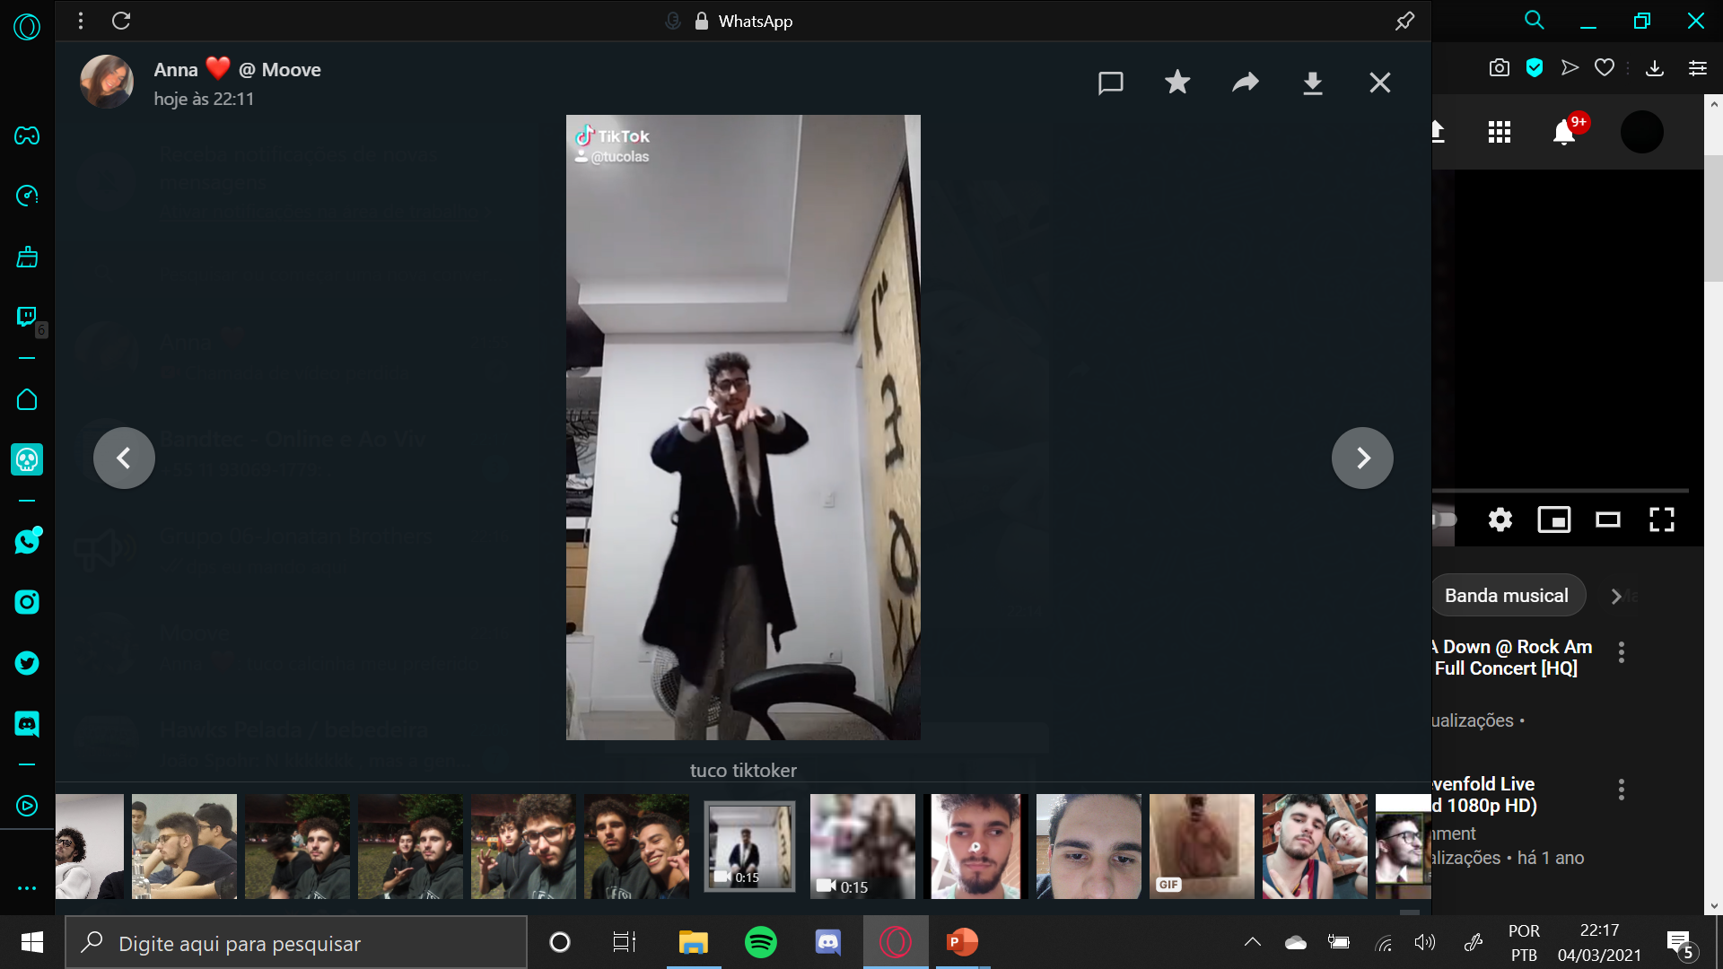
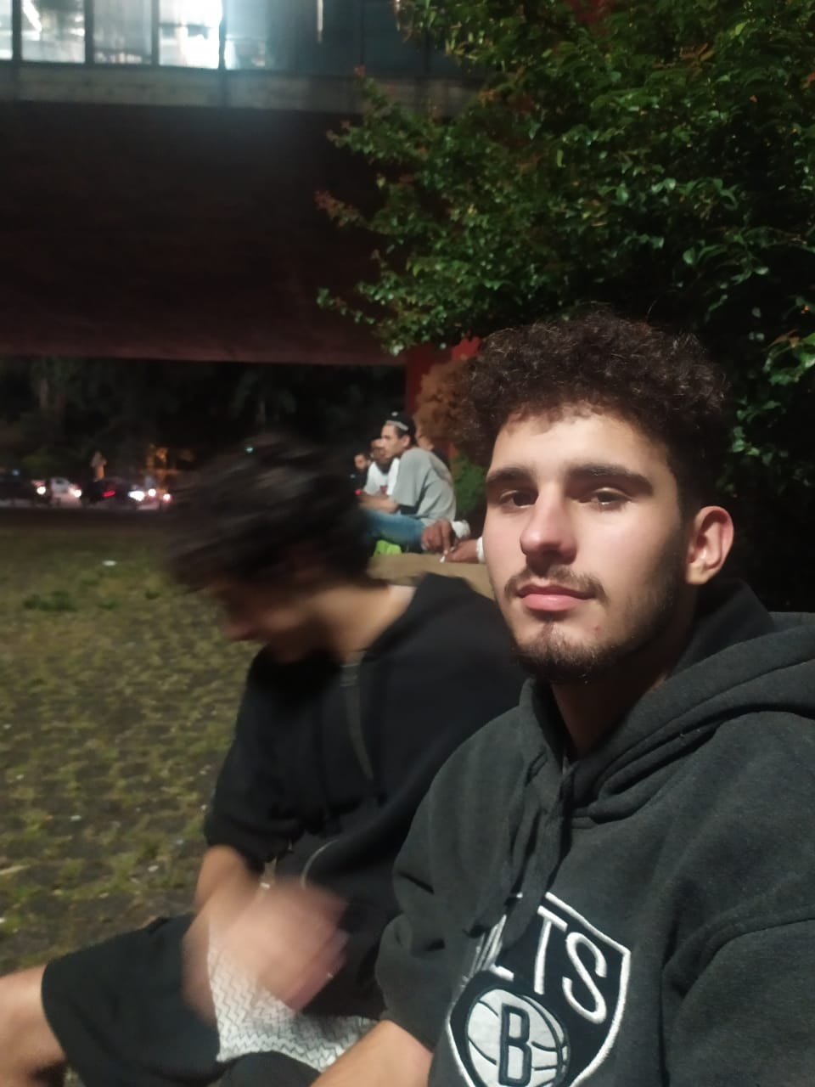

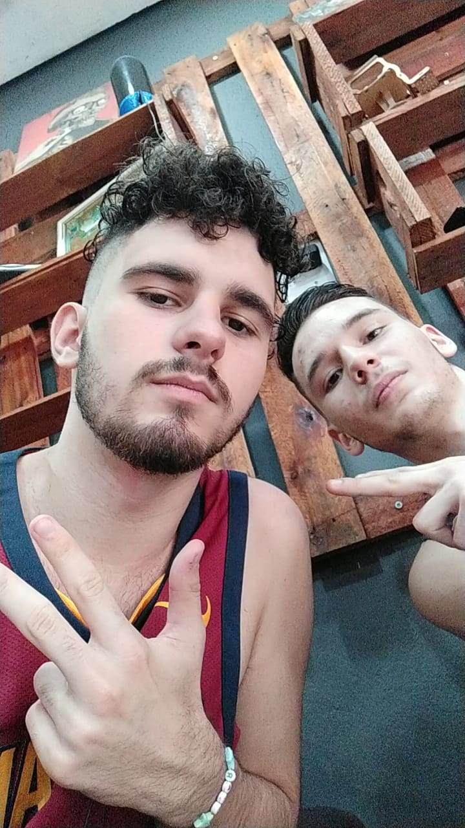
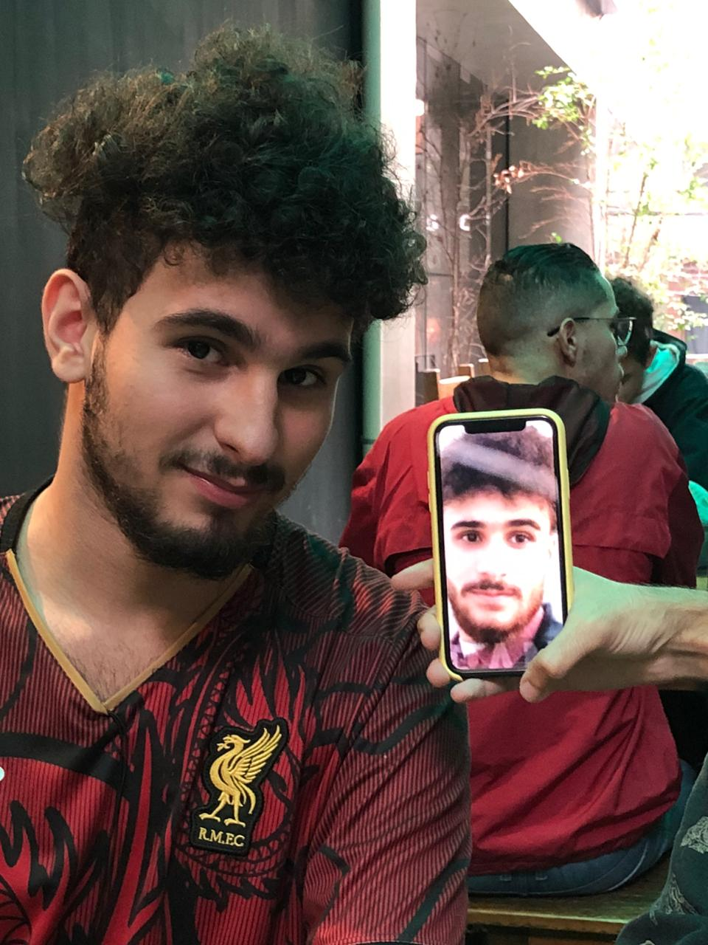
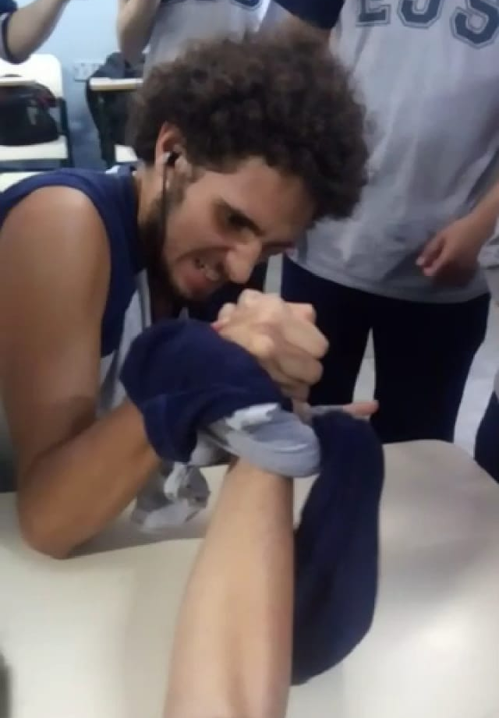
Tuco
TUCO
GOSTOSA
TUCO
DORMINDO V
TUCO
DORMINDO VI
TUCO
CHIQUINHA
TUCO
DANÇARINO
Tuco
TUCOVERSO
TUCOVERSO
TUCO
BEBADO
TUCO
FELIZ
TUCO
PEAKY BLINDER
TUCO
AO QUADRADO
TUCO
PORRADEIRO

